Slide 1

2019 Spring In-Service
February 7, 2019

Slide 2
Event Point
“highspeed”
Please do not connect your
cell phone to the WI-FI

Slide 3
February 7, 2019
Morning
  Fabrizio Lofaro – Valley ROP Superintendent Updates
  Maria and Drey - In-service Opening –Reminders
  Maria Meraz – Upcoming Events and Announcements
  Drey Castro – Bi-Annual Course Outlines and Career Education/Exploration
Afternoon
  Valley ROP Office updates - Budget & Financial Deadlines
  Competencies
  Upload CANVA
  Department Collaboration

Slide 4
Superintendent Updates
Mr. Fabrizio Lofaro

Slide 5
CTE Incentive Grant OUTCOMES 2015-2018
Outcome | 2015 | 2018 | Change
Students Impacted | 3859 | 6125 | +58%
Dual Enrollment/Articulations | 48 | 201 | +318%
HS Students Enrolled in College | 720 | 3015 | +318%
High-Quality Pathways | 62 | 99 | +59%
Industry Certifications | 485 | 2114 | 335%
CCI Matrix Impact | No Impact | All Schools | 100%
Number of Internships | 47 | 200 | 325%
Hours of Work Based Learning | 35,499 | 78,356 | 120%
K-8 CTE Courses - Outreach and Enrichment | 10 | 48 | 380%

Slide 6
CTE Incentive Grant
Growth and Achievements 2015-2018 (hand out)
Ongoing Funding / Competitive Grant
CAROCP is legislating for $300M
Positive Considerations to applicants that are Joint Power Agreements (JPA)

Slide 7

CTE Incentive Grant
Based on Labor Market Indicator
Based on the High Quality CTE Indicators (Per Pathway)
  Complete pathways (Concentrators/Capstones)
  Work Based Learning
  Strong Advisory/Business Partnership
  Dual Enrollment

Slide 8

CTE Incentive Grant OUTCOMES:
Reporting Requirements:
The high school cohort graduation rate
The number of pupils completing CTE coursework
Students Meeting the CCI performance
  Prepared/Approaching prepared
Industry Certifications
Students enrolled in post secondary institutions/Job Training.

Slide 9


K-12 Strong Workforce Program
$150 million – administered by CCC
Emphasis on collaborative approach between systems
Create, support, and/or expand high-quality career technical education programs at the K-12 level that are aligned with the workforce development efforts occurring through the Strong Workforce Program and regional priorities
Increase the transition from secondary to post secondary and career
Competitive; available only to K12
Success Indicators:
High Need, High Demand and High Pay Jobs
Align Curriculum with Dual Enrollment
Industry Certificates
Paid Internships or Work Place Learning
Increase students enrollment and exposure
Transition to post-secondary

Slide 10



K-12 Strong Workforce Funding
Areas of High Need in the Central Region:
Ag. Mechanics/Manufacturing
(Reedley College)
Health Careers and Patient Care
(Fresno City College)
Emergency Services
(Fresno City College)

Slide 11



CTEIG
VALLEY ROP
K12 SWP

Slide 12

CAROCP Promotional CTE Video.

Slide 13


CTE Promotion
Share Success with:
  GET SOCIAL! @valleyrop (twitter)
  School Paper
  Local News Paper
  SHARE YOUR CANVA FLYER!!
  CAROCP (California Association of Regional Occupational Centers and Programs)
  Promo VIDEO – LINK

Slide 14
Why promote a pathway?
Provides high-quality career opportunities
Elevates career education to world-class level
Greatly expands & improves opportunities for work-based learning (Internships, Job Shadowing, etc.)
Dual Enrollment opportunities and college credits
Industry Certifications
Start career exploration
Leadership Skills (CTSO)

Slide 15

Dual Enrollment

Slide 16
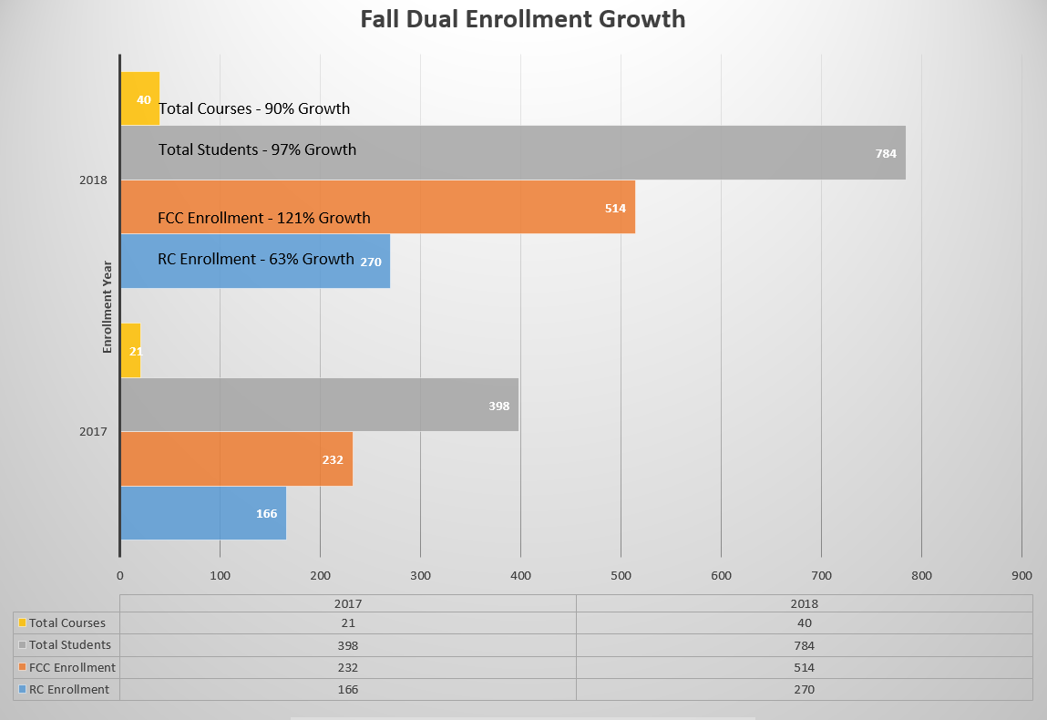
Dual Enrollment Success

Slide 17
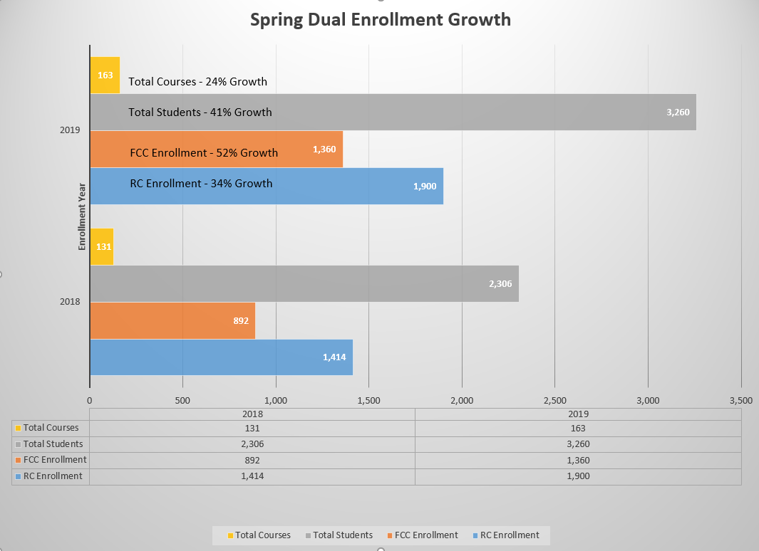

Slide 18
Dual Enrollment Timeline
Roster Verification (Census) | Check Webadvisor February 4th – 12th Full-term | Drop students in Webadvisor before submitting census Roster Verification (Census) Print copy of roster and place in VROP box (sealed envelope)
Last day to DROP students with an "W" | March 15, 2019 | Drop students in Webadvisor
FINAL GRADES and Attendance | May 31, 2019 | Excel Spreadsheet Template for Grades (use revsied one) Ask your Registrar Office for attendance log from 1st week of Spring instruction to May 31, 2019 Enter and submit grades electronically through Webadvisor Upload grades and attendance as one (1) .pdf file or as a separate file on Webadvisor & Schoology for each of your sections.

Slide 19
Dual Enrollment Evaluations
Feb 19 - Apr 1
Please notify the main office that you will have a college representative coming to conduct a dual enrolment evaluation.
Evaluation: 50 minutes long that will consist of a 30-35 minute lecture followed by a 15-20 minute student survey.
Select one topic, one course objective, and a Student Learning Outcome (SLO) listed in the course outline.
Please prepare a folder with the following materials in the event they are requested by the evaluator.
Evaluation Folder Contents:
      A printed copy of your syllabus.
      Attendance Roster
      Current Student Grades
      Printed copies of assignments/projects students will complete throughout the class. Example: instruction handouts, PowerPoint presentations, lesson plans (no dates) (no samples of student work)
      Mid-term (if you give one)
      Final Exam with a grading rubric
When delivering your lesson, please focus on the following best practices:
  Facilitate critical thinking
  Sufficient material to make and sustain eye contact with students
If applicable, demonstrate proper use of equipment.

Slide 20
Valley ROP
Internships and Scholarships
Reedley College
    Manufacturing Automotive
    Forestry Tech Firefighting (Wildland)
    Automotive
Fresno City College
    Fire Academy
    Emergency Medical Technician (EMT)

Slide 21
Internships at your District
KCUSD
Selma USD
Dinuba USD
Orosi USD
Sanger USD

Slide 22
Upcoming Events
Skills USA Regional Competition
    2/23/19, Paso Robles HS
JAM on Tuesday March 12, 2019
    Online Enrollment – Job Speaker
CSC FCC – Thursday March 14, 2019
    Registration: January 29 to February 5 with Restrictions (closed)
    Registration: February 12, 2019 without site limitations
Tiger ROmP – Thursday April 4, 2019
    Registration: February 25th to March 8th with Restrictions
    Registration: March 11th to the 15th without restrictions.
    News and Updates

Slide 23

Join Advisory Meeting
Tuesday, March 12 – Reedley College Cafeteria
Contact your Business Advisory Members
5:30 – 6:30 Dinner will be served
6:45 – 8:30 Break Out sessions
(Valley ROP teachers, Reedley College instructors, Business Advisory Members)

Slide 24
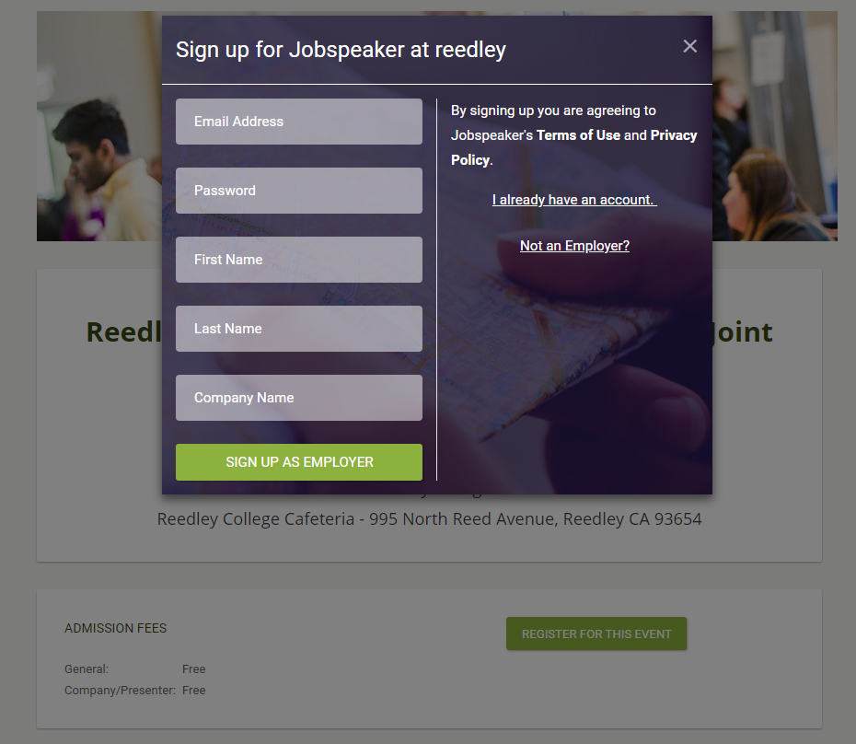
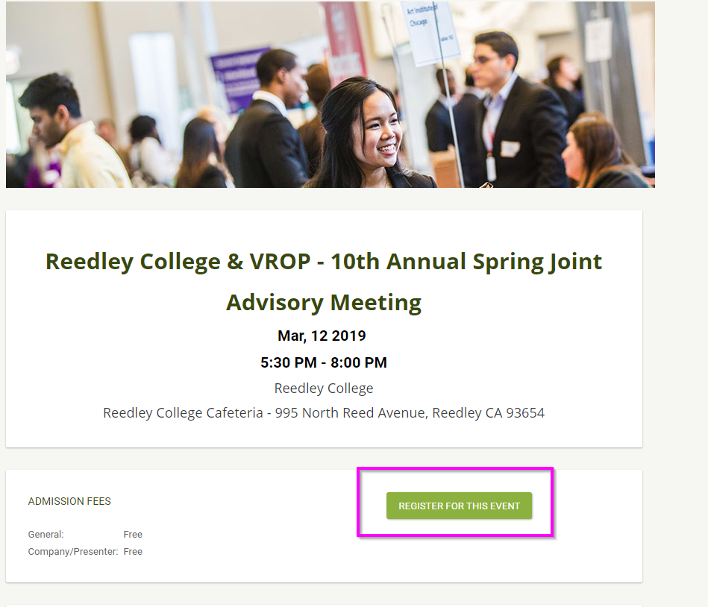
How to Register for the JAM
JOB Speaker to register for JAM - bit.ly/2019JAM

Slide 25

6th Annual Tiger ROmP
Thursday, April 4, 2019
@Reedley College

Slide 26
2019 Competitive Events
2D-3D Animation
Automotive
Animation
Child Development
CAN
CI Agility Course
CSI
Culinary
Entrepreneurship
Engineering
Fire Fighting
Job Interview Skills
Medical Terminology
MS Word Formatting
Skills USA
Robotics
Sports Medicine
Video Game Design
Video Production
Welding
Wildland Fire Fighting
Floral Design

Slide 27


Career Exploration for middle school students
All Sites
One week long
Maria and Drey will send out email for Courses/Teachers interest
Part of CTEIG HQ Indicator

Slide 28
WORKSHOP #1
Task #1: Learning Outcomes
Task #2: Career Education and Work Exploration/Skills

Slide 29
Where do you find
Course Outline?
Go to
Valley ROP website

Slide 30
Task #1
Bi-Annual Course Outline
“Learning Outcomes”
1. If you are a DuE course, add Learning Outcomes to the outline. See Tan handout.
2. Upload to Schoology.
3. If you are not a DuE course, go to Task #2.

Slide 31
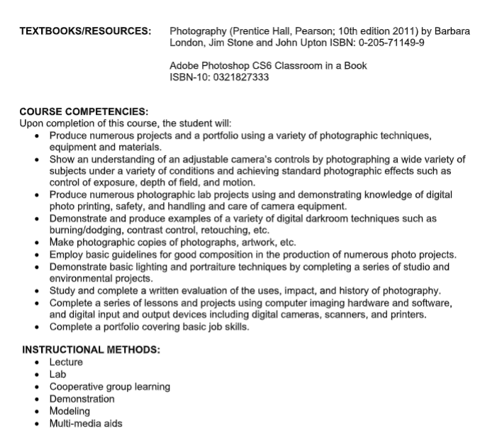
Dual Enrollment Courses only:
Learning
Outcomes

Slide 32
Dual Enrollment Courses only:
Learning
Outcomes

Slide 34
Task #2
Bi-Annual Course Outline
“Career Education and Work Exploration/Skills”
Before finalizing Units and Key Assignments in your course outline, do you have a specific unit that addresses Career Education and Work Exploration/Skills?
See Green hand-out.
See sample language.
Use the CTE Framework booklet to check for accurate anchor standards and pathway
standards.

Slide 36
A message from Governing Board Member
Mr. Mike Hernandez

Slide 37
Celebrate Success – CTE has a Voice!
Student “Prepared” & “Approaching Prepared”
Industry Certifications
Job Shadowing and Internships
Dual Enrollment
Work Based Learning

Slide 38
2018-2019 Career and College Indicators
  ALL schools in Blue or Green!!!!

Slide 39









YOU ARE CHAMPIONS OF CTE
& STUDENT SUCCESS

Slide 40

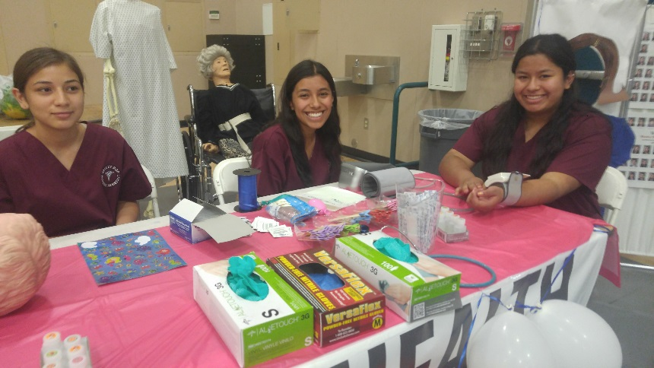
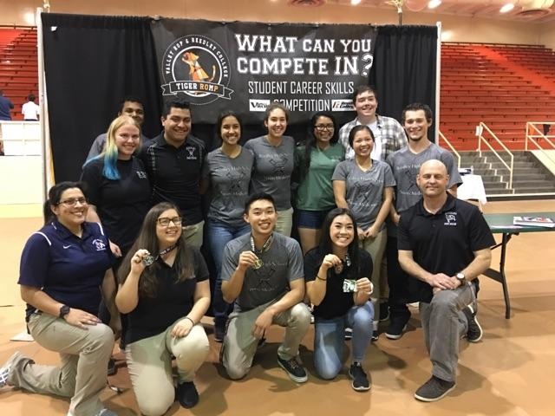


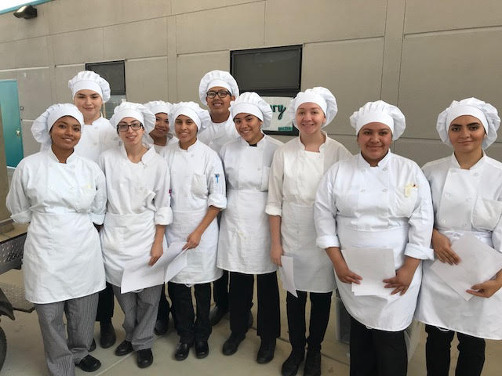
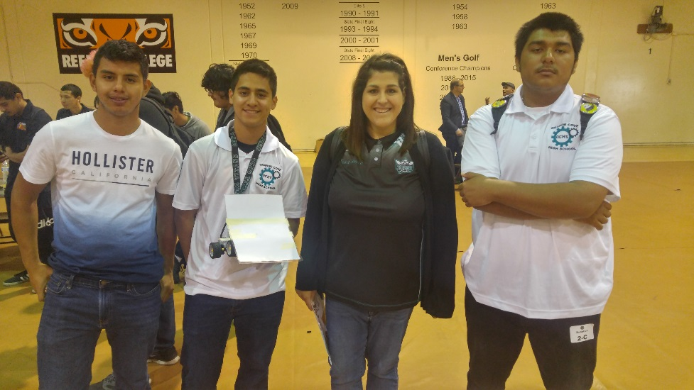
CTE is to students what
UC “a-g”, AP & Honors is to others

Slide 41

Education alone is not enough
Skills Combined with
Education and Rigor
Is the Key for Employment.

Slide 42

        Valley ROP Procedures
Budgets
Technology Tickets
Attendance and Rosters

Slide 43
Budgets
    Requisition Deadline:
      Date: Wednesday, April 10, 2019.
      Remember to put the Requisition in the VROP Mailbox on campus before the due dates. Requisitions received after this date may not be processed.
      One Requisition per Vendor.
      All Requisitions must be filled out completely.
      Indicate the item/catalog number for each item.
      Do not order over your available budget balance. If in doubt, email or call for your available balance.
    Open Purchase Orders - Deadline:
      All open Purchase Orders will have a MUST BE USED BY April 30, 2019 date printed on the PO. All PO’s will have to be exhausted by this date or the PO will be closed automatically and no more purchases can be made after this date.

Slide 44

Class Budget Development
  Budget development guidelines and procedures for the next school year will be sent out with a Budget Worksheet.
  Note: Refer to the Budget Categories to create your budget and complete your Budget Worksheet.
  Deadline to submit the Budget Worksheet will be: Wednesday, April 10, 2019
  Note: Failure to submit a Budget Worksheet will result in a Zero Budget for the new 2019-2020 school year.
  Upload to Schoology.com

Slide 45
Reminders…
Purchases:
  Make sure you sign all receipts.
  All items will be delivered to the Valley ROP Office and should be picked up by the instructor.
  If the items are delivered to your site under special circumstances please remember to return the Pink Copy of the Purchase Order that was sent back to the Valley ROP Office.
Time Cards:
Every one who is required to submit a monthly time card has received the list of Time Card due dates.
Time cards are due at 4:00pm on the due date.
Remember to indicate an explanation for hours that are out of your regular contracted time.
If you need authorization from a site administrator, you have a responsibility to get it before the due date.
Failing to submit your time card on time will eventually reflect on your performance to follow directions.

Slide 46
Reminders continued…
New Leave Request/Verification Form:
  Fill out Google Form located on Valley ROP website.
  Submit prior to the absence.
  Valley ROP office will immediately receive the request.
  Via email, a PDF is automatically generated.
  ALL TEACHERS need to print and sign the PDF and return the signed hard copy to VROP office.

Slide 47
Vehicle/Walking Permit
Updates and Revisions
Any instructor who turns in vehicle/walking permits as per their course:
Rule #1: Any student who travels off campus MUST have a vehicle/walking permit on file. NO EXCEPTIONS!
Rule #2: Make sure all student forms are current and updated with any new revisions. Note: if a student becomes a licensed driver at any time during the school year, his/her forms need to be updated.

Slide 48


Grades and Credits
Single period classes = 5 credits/semester
Full year single period students and completed class should have 10 credits by the end of course. For example:
1st semester Jane Doe- “A” 5 credits
2nd semester Jane Doe- “A” 5 credits
*We want to see 10 credits received for student who completed that class for
full year when inputting your credits.
Double period classes = 10 credits/semester
Full year single period students and completed class should have 10 credits by the end of course for example:
1st semester Jane Doe- “A” 10 credits
2nd semester Jane Doe- “A” 10 credits
*We want to see 20 credits received for student who completed that class for
full year when inputting your credits.

Slide 49
Check Out
Vehicle Request for Conference/Field Trip
Form available on VROP Website:
(Resources → For Teachers → Select Valley ROP Teacher Handbook).
1. Complete form with description of request.
*Be specific: field trip vs conference (two different funding sources)
2. Turn in to the VROP box at your home school site or turn in to our
VROP office
3. “First come First serve” when requesting a vehicle.

Slide 50
End of the Year
Procedures
Community Classroom/Work Based Learning hours log
Inventory
Grades and Credits in eClass

Slide 51
WORKSHOP #2
“Competencies”
&
Department Meetings

Slide 52
Final Task
“Competencies”
  Review Competencies – Blue hand out
  Upload CANVA onto Schoology.com
  Other PLC items – Department Collaboration

Slide 54
Before Leaving Today…
Did you?
  Upload Course Outline onto Schoology.com
  Upload CANVA onto Schoology.com

